Slide 1
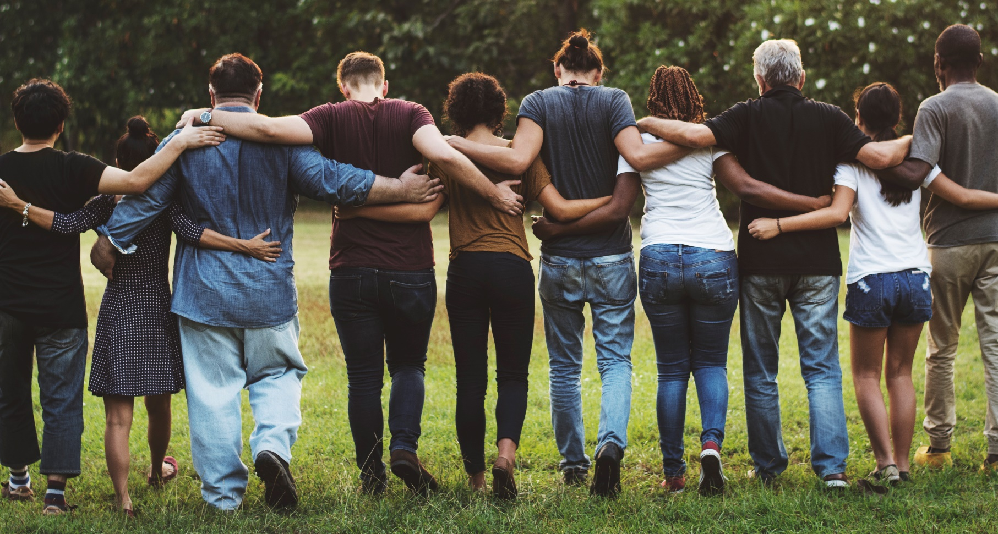
COMMUNITY PLANNING MEETING JULY 12, 2018
Facilitator: Christina Holt

Slide 2
Tonight’s Agenda
Douglas County Community Health Improvement Plan Charge
Access to Healthy Food
Physical Activity
Potential Strategies
Next Steps

Slide 3
Lawrence-Douglas County Framework for Understanding and Addressing Health and Health Equity
Broader Context: National, regional, and state values, beliefs, history, attitudes, and media; history of accumulated race privilege; barriers to opportunities; contemporary culture.
People Factors
Community Factors
Behavioral Factors
Clinical Factors
Population Outcomes
Pregnancy
Early childhood
Childhood
Adolescence
Adulthood
Older adults
Income, Jobs, Wages
Education
Housing (Access, Affordability, Habitability)
Food Security
Health-promoting policies
Transportation
Childcare (affordability, quality)
Marketing for tobacco, alcohol, food
Built Environment (Recreation, Food)
Environmental quality (water, air, soil)
Access to communication and information
Predatory business practices
Participation (social, political, civic)
Political influence
Organizational networks
Discrimination
Segregation
Social cohesion
Social support
Social inclusion
Violence
Incarcerations
Quality of Life
Quality adjusted life year
Chronic stress
Morbidity
Burden of:
Infectious disease
Chronic disease
Injury (intentional & unintentional)
Oral/dental disease
Mental & behavioral illness
Mortality
Life expectancy/Length of life
Infant mortality
Life Course
Racial and ethnic minorities
Gender
Immigration status
Low-income, in poverty
People with disabilities
Sexual orientation
Geographic location
Single parent households
Mental
Access to mental health providers
Utilization of mental & behavioral health services
Physical
Access to primary care
Access to prenatal care
Provision of preventive care services
Utilization of emergency department for preventable causes
Ratio of Active Health Professionals
Health insurance coverage
Oral
Access to dental care providers
Utilization of dental care
Equity across
Populations
Risk Behaviors
Tobacco use
Alcohol and drug use
Risky sexual behavior
Health-seeking behaviors
Healthy eating
Physical activity
Utilization of preventive care services
Pro-social factors
Civic engagement
Engagement in services
Self-efficacy
Hopefulness
Strategies for Addressing Health and Health Equity :
Data collection, monitoring, and surveillance
Community engagement and capacity building
Policy and environmental changes
Systems change
Coordinated interagency efforts
Population-based interventions to address health factors

Slide 4
Community health improvement plan
Poverty and jobs
Behavioral health
Safe and affordable housing
Access to healthy food and physical activity
Equity & Discrimination
Notes:
def. - long-term, systematic effort to address public health problems on the basis of the results of community health assessment activities and the community health improvement process. This plan is used by health and other governmental education and human service agencies, in collaboration with community partners, to set priorities and coordinate and target resources. A community health improvement plan is critical for developing policies and defining actions to target efforts that promote health. It should define the vision for the health of the community through a collaborative process and should address the gamut of strengths, weaknesses, challenges, and opportunities that exist in the community to improve the health status of that community.

Slide 5
Our Task
Goal statements
Objectives (SMART+C)
Specific strategies that reflect a mix of policy, systems, & environmental changes and evidence-based strategies
Action steps
Implement

Slide 6
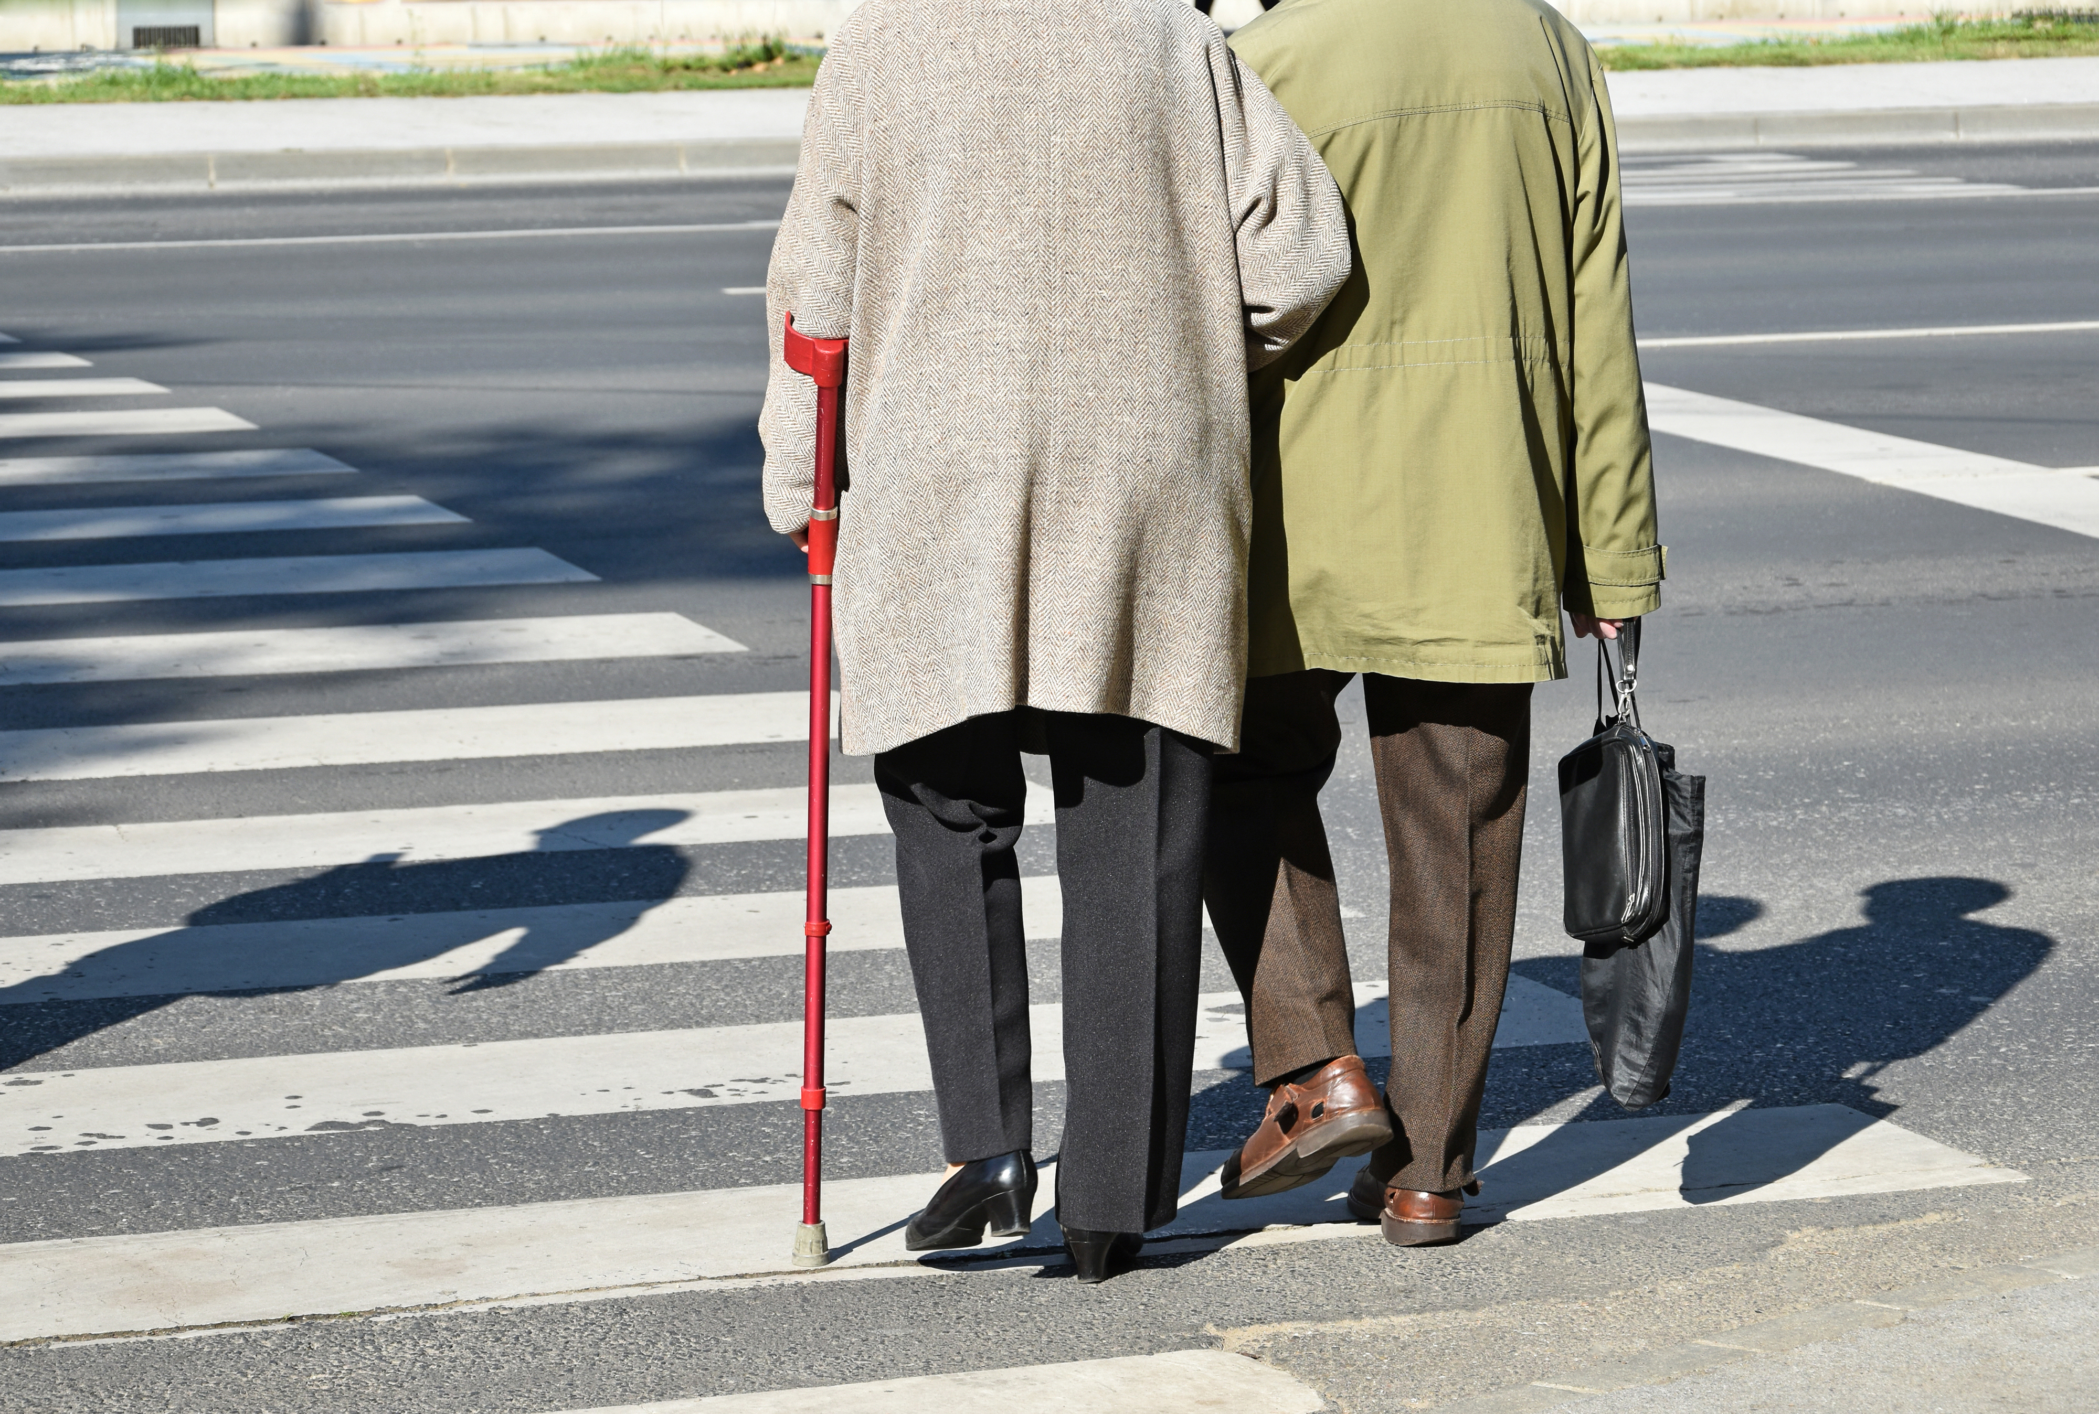
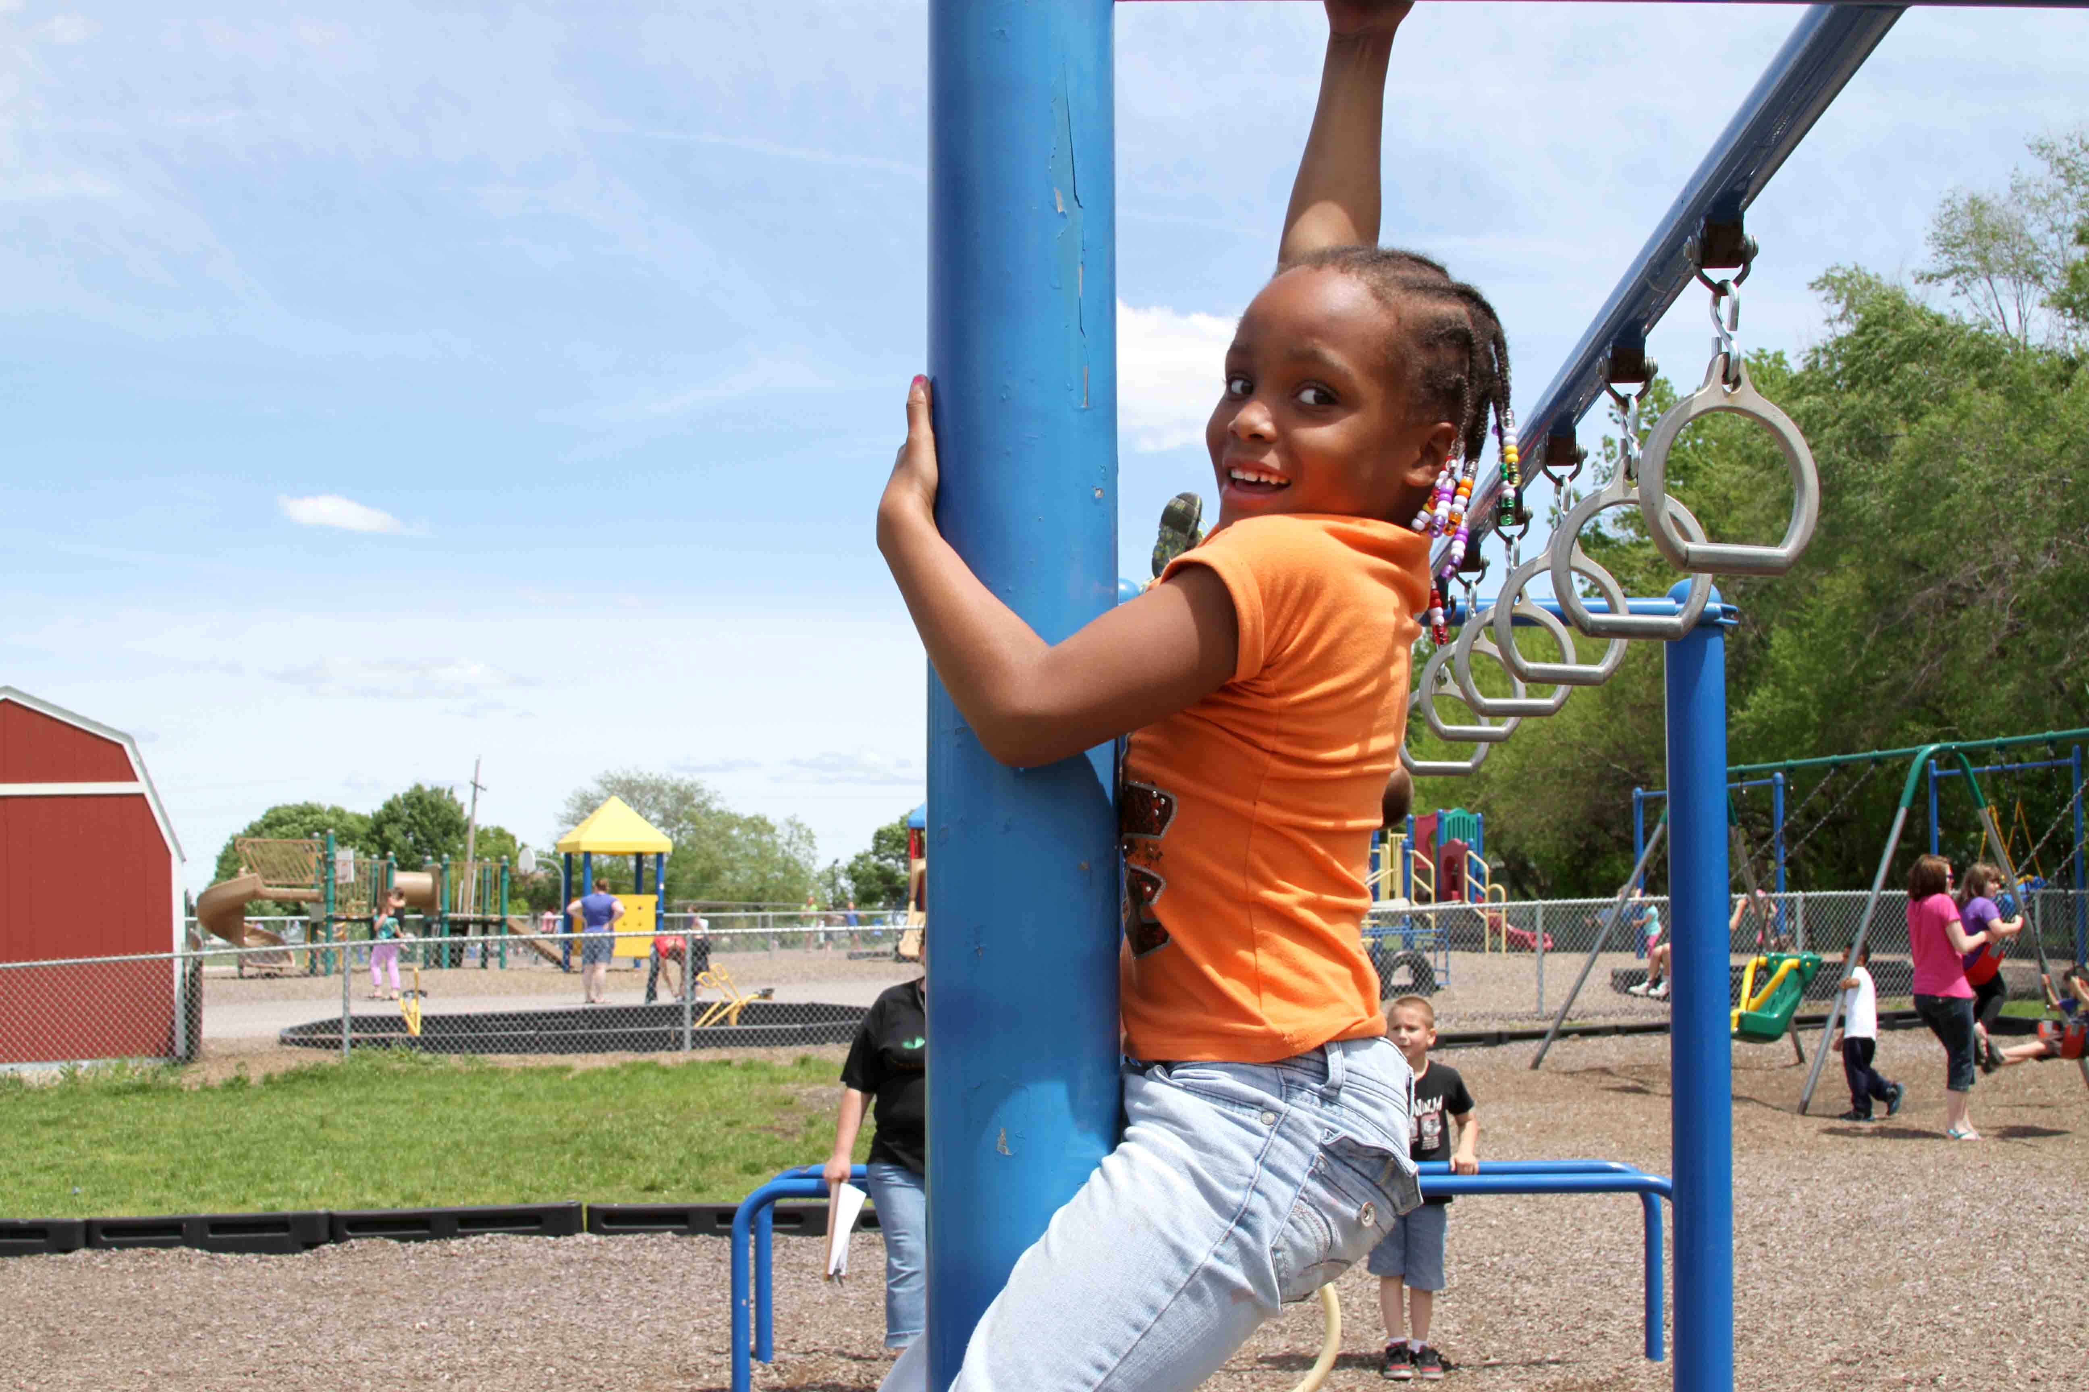
LiveWell Vision and Mission
Our Vision: Communities where we all thrive.
Our Mission: Leading a movement to build communities that support the health and well-being of all.

Slide 7
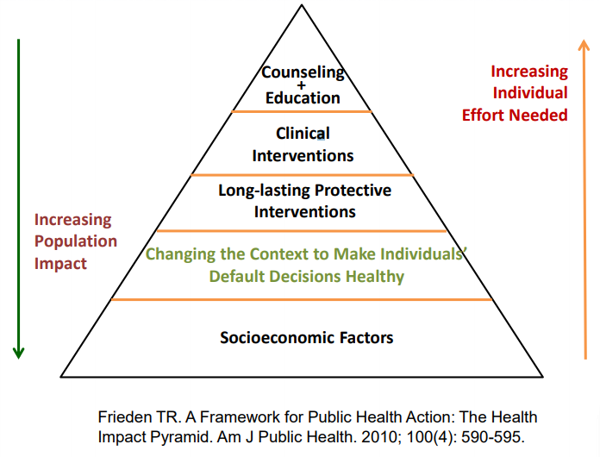
HEALTH IMPACT PYRAMID
Notes:
This figure illustrates the importance of population-based approaches.

Slide 8
PHYSICAL ACTIVITY

Slide 9
ACCESS TO HEATHY FOOD

